Slide 1
1
2
3
Well #1
Well #2
Well #3
1 | well #1 operating status
2 | well #2 operating status
3 | well #3 operating status
4 | flow line pressure from well #1
5 | flow line pressure from well #2
6 | flow line pressure from well #3
7 | flow line pressure gas rate oil rate water rate gas liquid ratio gas oil ratio water cut
8 | total oil flow rate
9 | total gas flow rate
10 | total water flow rate
Production Lines
From Wells
4
5
6
Production Header
multi-phase flow meter
7
8
Separator
oil
gas
9
10
water
flow measurement
facility parameter

Slide 2
1
2
3
A
B
C
1 | well #1 operating status
2 | well #2 operating status
3 | well #3 operating status
4 | flow line pressure from well #1
5 | flow line pressure from well #2
6 | flow line pressure from well #3
7 | flow line pressure gas rate oil rate water rate gas liquid ratio gas oil ratio water cut
8 | total oil flow rate
9 | total gas flow rate
10 | total water flow rate
1
3
5
4
5
6
2
G
4
6
7
7
8
H
oil
8
9
11
10
gas
9
10
water
flow measurement
facility parameter
port

Slide 3
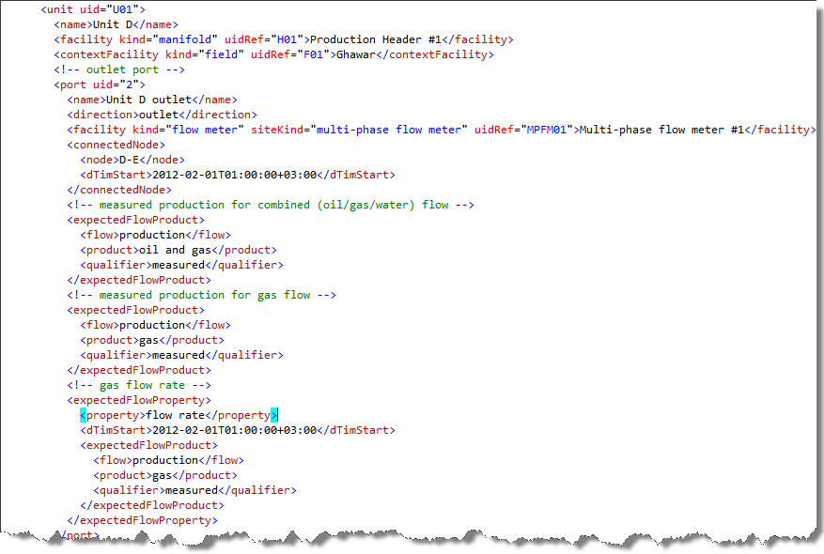
2
4
6
Production Header
Unit D
multi-phase flow meter
7

